Slide 1

Wavecon Telecom Analysis

Slide 2
Agenda
Introduction
Impact of 5G Launch on Revenue
Underperforming Key Performance Indicators (KPIs)
Outperforming Key Performance Indicators (KPIs)
Market Share
Plan Analysis
Recommendation

Slide 3
Introduction
Wavecon Telecom is a leading telecommunication company in India, which provides telecom services to individuals and businesses.
Wavecon Telecom is the 3rd largest telecom service provider in term of Market share, the company that's changing the way we connect in India.
They've just rolled out 5G, the next big thing in wireless tech.
With super-fast internet and better connections, Wavecon is making our digital lives better.
This is a big step for India, and Wavecon is leading the way.
Get ready to experience the future of communication with Wavecon's new 5G network!

Slide 4
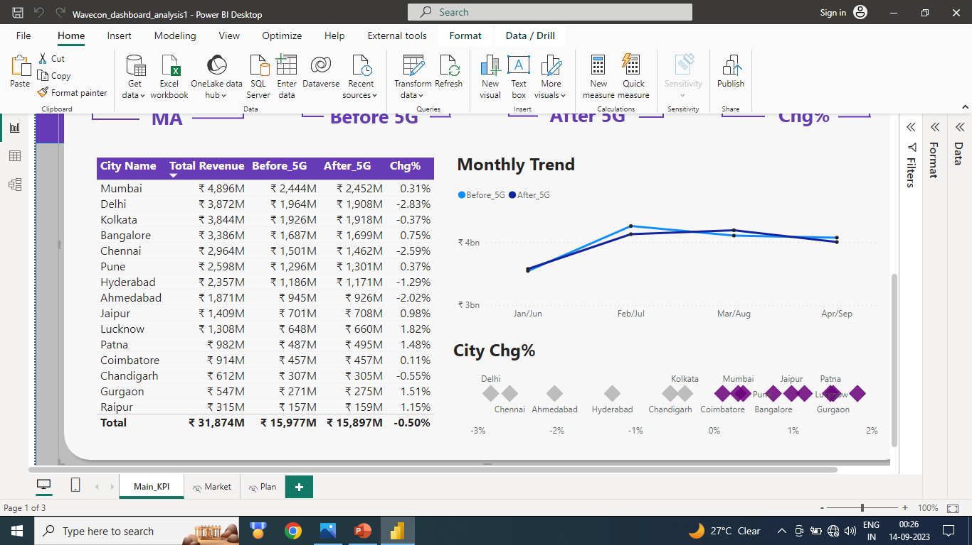
Impact of 5G Launch on Revenue
As depicted in the visual, cities such as Lucknow, Patna, Gurgaon, and Raipur have experienced a positive impact on revenue. In contrast, cities like Delhi, Chennai, Ahmedabad, and Hyderabad have witnessed a negative impact on revenue.
When we compare the overall revenue after the launch of 5G, it becomes evident that there has been a decrease of -0.50%. Prior to the 5G launch, the revenue stood at 16.0 million, but following the launch of 5G, it decreased to 15.9 million.

Slide 5
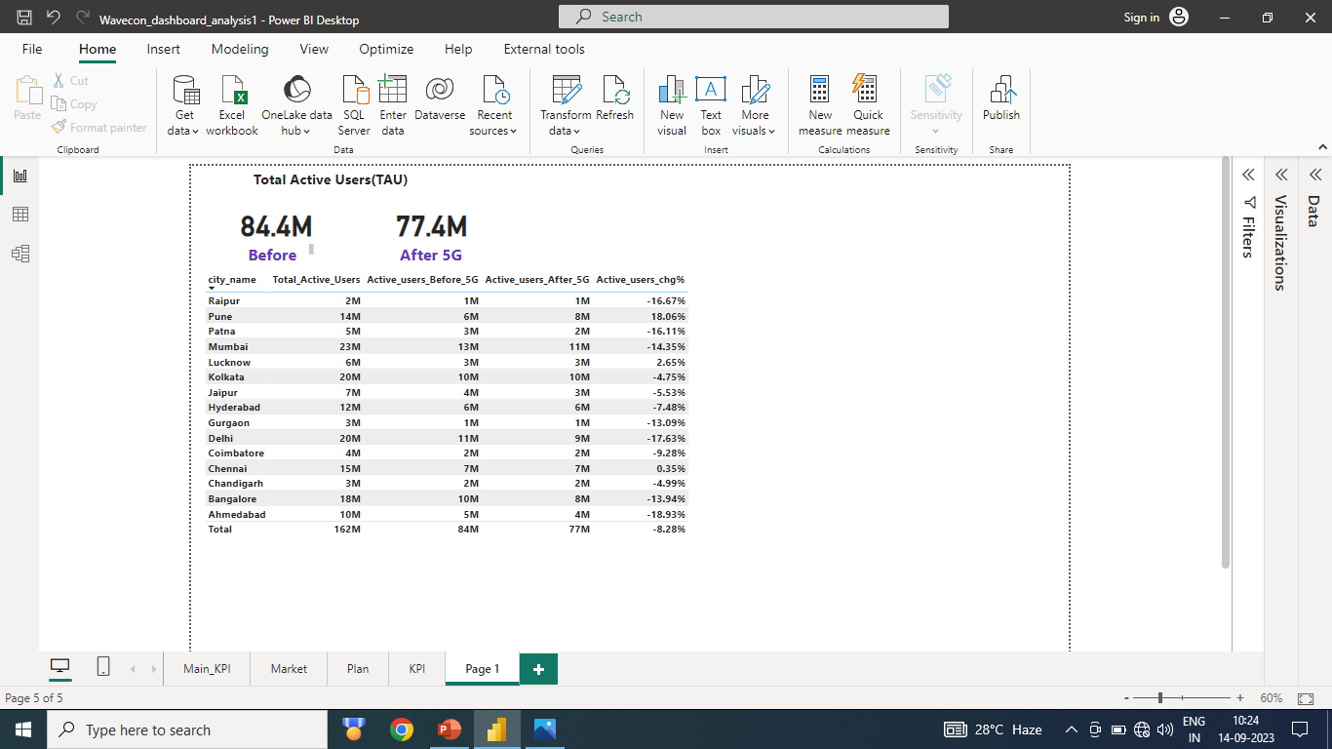
Underperforming Key Performance Indicators (KPIs)
The visual above clearly illustrates that the total number of active users has decreased following the introduction of 5G technology. This impact is particularly noticeable in major cities such as Delhi, Ahmedabad, Mumbai, and Patna, where there has been a significant decrease of -8.28% in total active users.

Slide 6
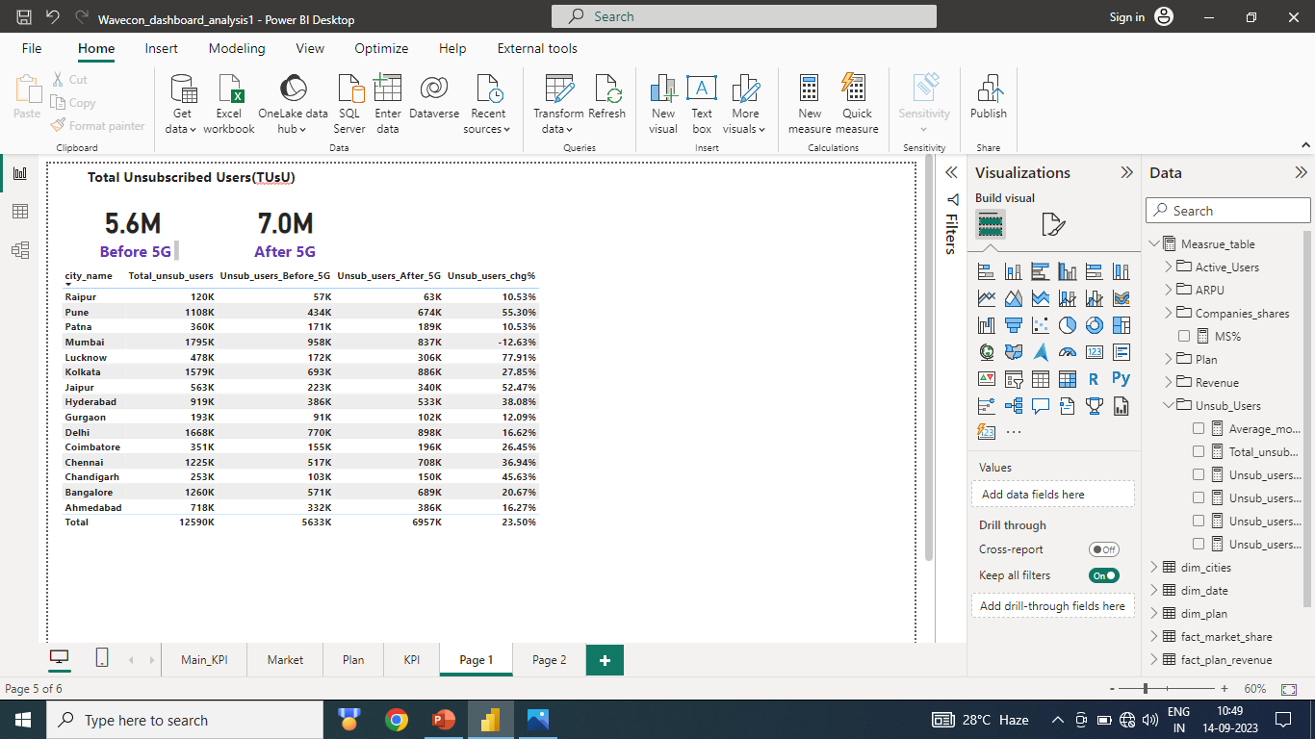
Underperforming Key Performance Indicators (KPIs)
Following the launch of 5G, the total number of unsubscribed users has increased from 5.6 million to 7.0 million. Unfortunately, all cities, with the exception of Mumbai, have shown poor performance in this regard. Particularly, cities like Lucknow, Pune, Jaipur, and Chandigarh have exhibited very disappointing results.

Slide 7
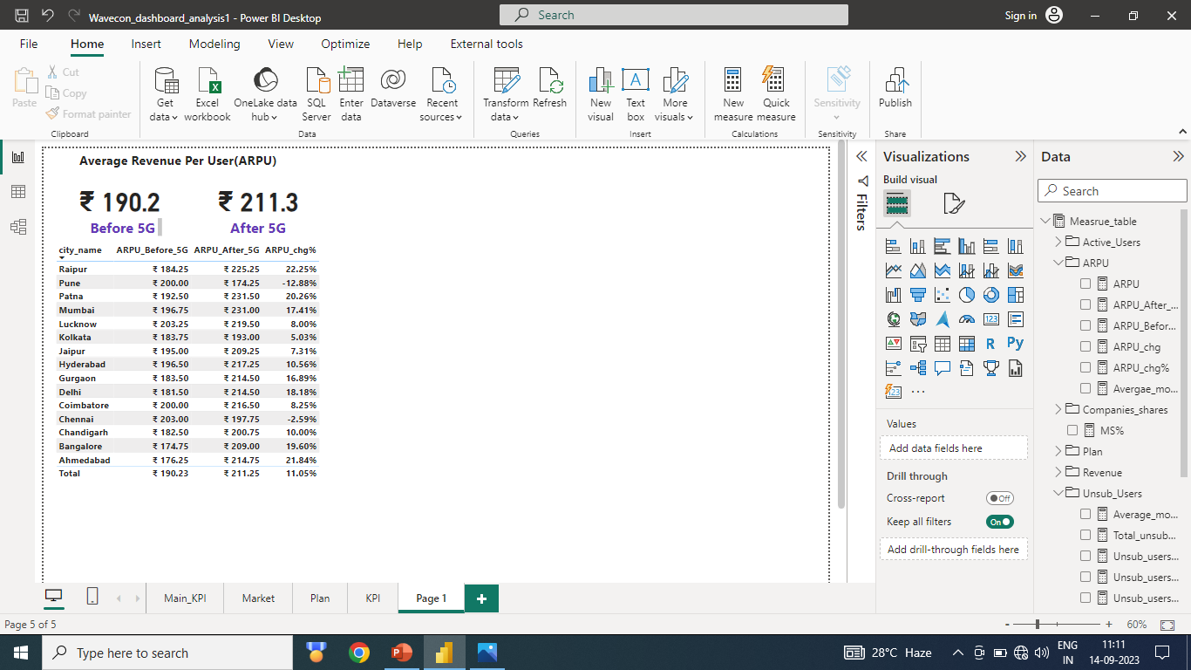
Outperforming Key Performance Indicators (KPIs)
The Average Revenue Per User (ARPU) has seen a significant increase from 190.2 to 211.3, representing a growth of 11.05%. Notably, the following cities - Raipur, Patna, Ahmedabad, Bangalore, Delhi, and Mumbai - are showing strong performance.

Slide 8
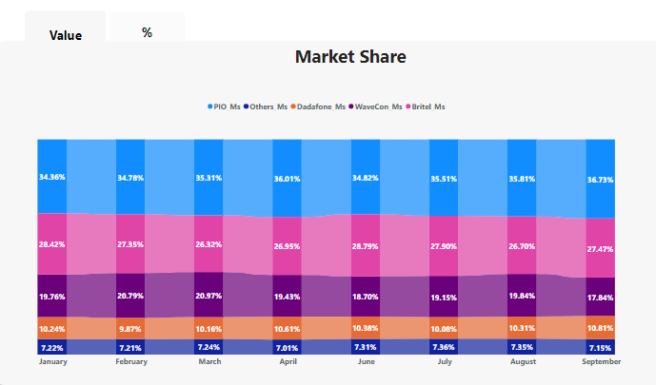
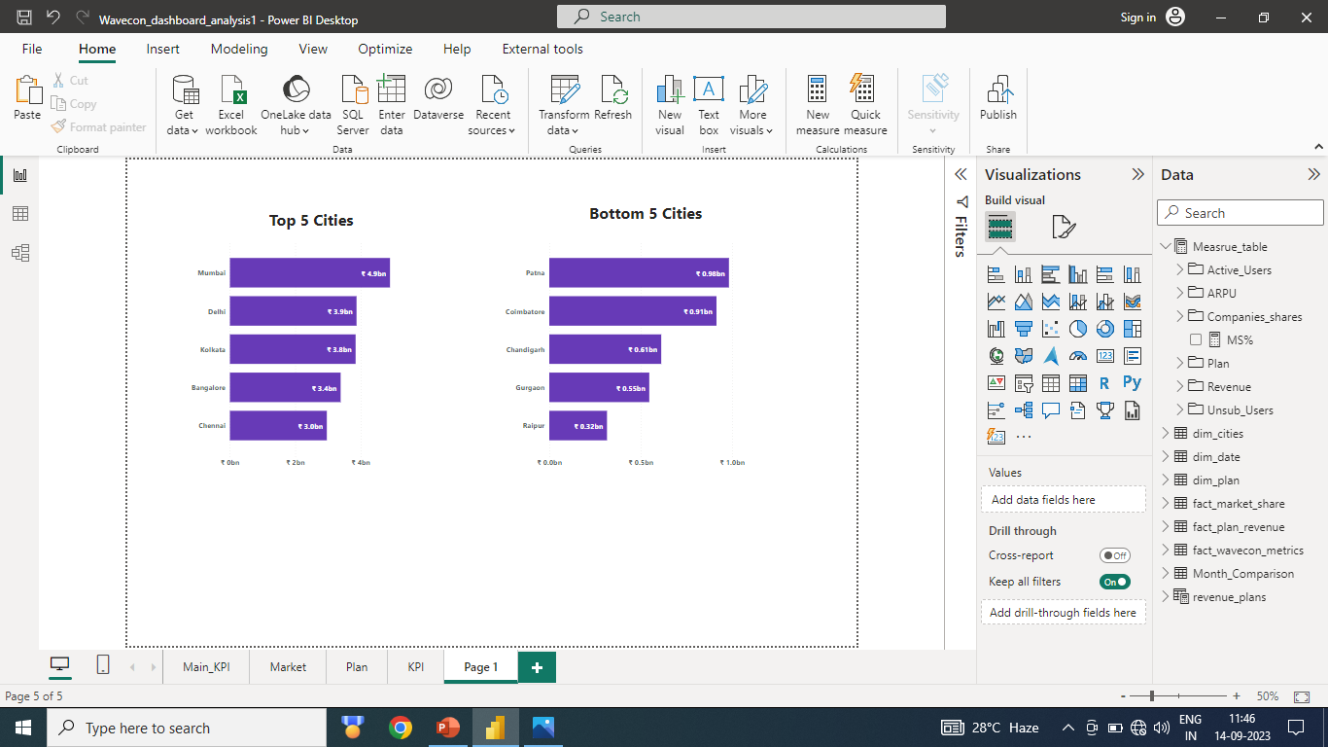
Market Share
In terms of market share, Wavecon Telecom currently holds the third position, with the majority of our revenue being generated from key metropolitan areas such as Mumbai, Delhi, Kolkata, Bangalore, and Chennai.

Slide 9
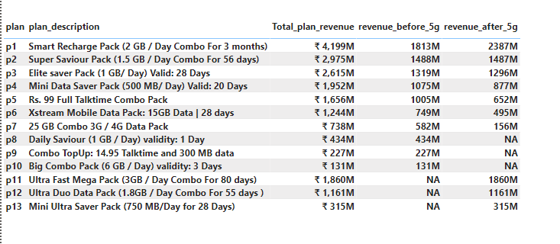
Plan Analysis
In our visual analysis, we have observed that Plan P1 is performing well after the 5G rollout. However, Plans P7 have experienced a significant drop in performance.
Plans P8, P9, and P10 have been discontinued following the introduction of 5G technology. On the other hand, Plans P11, P12, and P13 are currently exhibiting strong performance.

Slide 10
Recommendation
We need to examine Delhi, Chennai, and Ahmedabad because we are experiencing a significant loss in revenue there.
As we can see in our report, the total number of active users has decreased after the introduction of 5G, and the number of unsubscribed users has increased. This suggests that we may have shortcomings in our service quality that require improvement.
When we assess our market share, we currently hold the third position. However, we need to enhance our brand value by improving our 5G services in comparison to our competitors and offering unique features.
It is evident that many of our plans are not generating a substantial amount of revenue. Therefore, we need to make necessary adjustments to our existing plans.

